Slide 1
Chapter 14: Transactions

Slide 2
Chapter 14: Transactions
Transaction Concept
Transaction State
Concurrent Executions
Serializability
Recoverability
Implementation of Isolation
Transaction Definition in SQL
Testing for Serializability.

Slide 3
Transaction Concept
E.g. transaction to transfer $50 from account A to account B:
  1. read(A)
  2. A := A – 50
  3. write(A)
  4. read(B)
  5. B := B + 50
  6. write(B)
Two main issues to deal with:
  Failures of various kinds, such as hardware failures and system crashes
  Concurrent execution of multiple transactions

Slide 4
Transaction basics -- definition
A transaction is a unit of program execution that accesses and possibly updates various data items.
Can be defined as
  A set of SQL statements
  Stored procedures
  Initiated by high level programming languages (Java, C++ etc.)
Delimited by begin transaction & end transaction
Example:
  Begin transaction
  X = select salary from person where name = “Gao”
  update person set salary = x * 10 where name = “”
  Update person set salary = x / 10 where name = “”
  End transaction

Slide 5
Example of Fund Transfer
Transaction to transfer $50 from account A to account B:
  1. read(A)
  2. A := A – 50
  3. write(A)
  4. read(B)
  5. B := B + 50
  6. write(B)
Atomicity requirement
  if the transaction fails after step 3 and before step 6, money will be “lost” leading to an inconsistent database state
    Failure could be due to software or hardware
  the system should ensure that updates of a partially executed transaction are not reflected in the database
Durability requirement — once the user has been notified that the transaction has completed (i.e., the transfer of the $50 has taken place), the updates to the database by the transaction must persist even if there are software or hardware failures.

Slide 6
Example of Fund Transfer (Cont.)
Transaction to transfer $50 from account A to account B:
  1. read(A)
  2. A := A – 50
  3. write(A)
  4. read(B)
  5. B := B + 50
  6. write(B)
Consistency requirement in above example:
  the sum of A and B is unchanged by the execution of the transaction
In general, consistency requirements include
    Explicitly specified integrity constraints such as primary keys and foreign keys
    Implicit integrity constraints
      e.g. sum of balances of all accounts, minus sum of loan amounts must equal value of cash-in-hand
  A transaction must see a consistent database.
  During transaction execution the database may be temporarily inconsistent.
  When the transaction completes successfully the database must be consistent
    Erroneous transaction logic can lead to inconsistency

Slide 7
Example of Fund Transfer (Cont.)
Isolation requirement — if between steps 3 and 6, another transaction T2 is allowed to access the partially updated database, it will see an inconsistent database (the sum A + B will be less than it should be).
T1 T2
  1. read(A)
  2. A := A – 50
  3. write(A)
  read(A), read(B), print(A+B)
  4. read(B)
  5. B := B + 50
  6. write(B)
Isolation can be ensured trivially by running transactions serially
  that is, one after the other.
However, executing multiple transactions concurrently has significant benefits, as we will see later.

Slide 8
ACID Properties
A transaction is a unit of program execution that accesses and possibly updates various data items.To preserve the integrity of data the database system must ensure:
Atomicity. Either all operations of the transaction are properly reflected in the database or none are.
Consistency. Execution of a transaction in isolation preserves the consistency of the database.
Isolation. Although multiple transactions may execute concurrently, each transaction must be unaware of other concurrently executing transactions. Intermediate transaction results must be hidden from other concurrently executed transactions.
  That is, for every pair of transactions T_{i} and T_{j}, it appears to T_{i} that either T_{j}, finished execution before T_{i} started, or T_{j} started execution after T_{i} finished.
Durability. After a transaction completes successfully, the changes it has made to the database persist, even if there are system failures.

Slide 9
ACID Properties
To preserve the integrity of data the database system must ensure:
Atomicity.
  All or Nothing.
  Recovery sub-system
Consistency.
  correctness of the data-implicit and explicit
  Concurrency control and recovery
Isolation.
  Transactions must appear to be the only transaction that occurred
  Concurrency control sub-system
Durability
  The effect of the transaction must never be lost
  Recovery sub-system

Slide 10
Transaction State
Active – the initial state; the transaction stays in this state while it is executing
Partially committed – after the final statement has been executed.
Failed -- after the discovery that normal execution can no longer proceed.
Aborted – after the transaction has been rolled back and the database restored to its state prior to the start of the transaction. Two options after it has been aborted:
  restart the transaction
    can be done only if no internal logical error
  kill the transaction
Committed – after successful completion.

Slide 11

Transaction State (Cont.)
commit
rollback

Slide 12
Transaction States (cont.)
Active
  the initial state, the transaction stays in this state while it is executing from begin-transaction
  in this state, the transaction is created (after begin-transaction is submitted), resources, e.g. local buffer are allocated to the transaction
Note
  transaction operations are executed, but the modifications on DB issued by operations may only stored temporally in the disk buffer, not reflected to DB file on disks immediately

Slide 13
Transaction States (cont.)
Partially committed (部分提交) :
  after the final statement (i.e. Commit ) has been submitted, the transaction enters this state
  in this state, the influences that the transaction’s operations have made on DB are reflected from the disk buffer to DB by DBMS
  /*DBMS将disk缓冲区中的DB修改结果写入磁盘DB文件中
    e.g.

Slide 14
Transaction States (cont.)
Aborted (夭折/异常结束/中止状态)
  after the transaction has been rolled back in failed state, and the DB has been restored to its state prior to the start of the transactions, it enters this state to end the transaction
  /*表示DBMS已完成失败处理工作, 事务将要退出系统
  in this state, the transaction
    releases the resources occupied
    reports to its user that the transaction is aborted
    and then terminated (quits DBS)
    , the cycle-life of the transaction is ended
  e.g. Fig.15.0.6

Slide 15
Transaction States (cont.)
Committed
  after the transaction has successfully completed all its operations, and all the results of these operations have been reflected to the DB in partial commit state, it enters this state
  in this state, the transaction
    releases the resources occupied
    and then terminated (quits DBS),
    the cycle-life of the transaction is ended .

Slide 16
Transaction States (cont.)
Failed
  if it is discovered that normal execution can no longer proceed, the transaction enters this state
    e.g. Account_transfer T2 in Fig.15.0.1
  in this state, the transaction is rolled back to restore DB to the state prior to the start of the transactions (§17)
  /*在此状态下进行失败处理工作
  e.g. Fig.15.0.6

Slide 17
Transaction States (cont.)
begin-trans.
op₁;
op_{i};
…
op_{j};
op_{n};
commit.
e.g.
select
e.g. insert,
update
DBMS
allocate
resources,
e.g. local buffer;
create and start trans.
reflect data
to disk
release
Resources;
end trans.
local
-buff.
x, y
disk
-buff.
disk
partially
commit
states:
active
commit
Fig.15.0.5 Life-cycle of a successful/committed transaction

Slide 18
Transaction States (cont.)
begin-trans.
op₁;
op_{i};
…
op_{j};
op_{n};
rollback
e.g.
select
e.g. insert,
update
DBMS
allocate
resources,
e.g. local buffer;
create and start trans.
rollback
(undo or redo)
the previous
operations
release
resources;
end trans.
local
-buff.
disk
-buff.
restore
Disk
states:
active
failed
aborted
Fig.15.0.6 Life-cycle of a rollback transaction

Slide 19
An Example of Roll Back in Transaction
Roll back (回滚、滚回)
  撤销到目前为止事务已经对数据库做的所有修改，使数据库状态恢复到事务开始前的状态
E.g. define table SC as
create table SC
(s# integer,
c# integer,
grade integer,
check (grade between 0 AND 100 )
)
define the update transaction update-tran as:
update SC
set grade = grade + 5
where ….

Slide 20
restore/rollback the
tuples updated
update on some tuples
s# | c# | grade
101 | 1 | 85
102 | 2 | 55
201 | 2 | 75
210 | 5 | 100
401 | 3 | 77
… | … | …
510 | 2 | 60
s# | c# | grade
101 | 1 | 90
102 | 2 | 60
201 | 2 | 80
210 | 5 | 105
401 | 3 | 77
… | … | …
510 | 2 | 60
s# | c# | grade
101 | 1 | 85
102 | 2 | 55
201 | 2 | 75
210 | 5 | 100
401 | 3 | 77
… | … | …
510 | 2 | 60
(a) the initial
SC instance
(b) SC instance when failure occurs during execution of transaction, i.e. integrity is violated
(c) SC instance after roll back, i.e. canceling all the updates on SC having been made, equal to the initial instance

Slide 21
An Example of Roll Back in Transaction (cont.)
When tuple 1, 2, 3 have been successfully updated and tuple 4 is updated, the values of t4[grade]=105 >100, the integrity is violated
DBMS rollbacks the transaction update-tran
  restore the values of t1[grade], t2[grade], t3[grade] and t4[grade] to its initial values

Slide 22
Concurrent Executions
Multiple transactions are allowed to run concurrently in the system. Advantages are:
  increased processor and disk utilization, leading to better transaction throughput
    E.g. one transaction can be using the CPU while another is reading from or writing to the disk
  reduced average response time for transactions: short transactions need not wait behind long ones.
Concurrency control schemes – mechanisms to achieve isolation
  that is, to control the interaction among the concurrent transactions in order to prevent them from destroying the consistency of the database
    Will study in Chapter 16, after studying notion of correctness of concurrent executions.

Slide 23
Concurrent Executions (cont.)
With respect to a set of transactions, a schedule on this set is
  the execution sequences that indicate the chronological order in which instructions/operations of concurrent transactions are executed
  arranged by DBMS’ concurrency-control component
  note:
    a schedule for a set of transactions must consist of all instructions of those transactions
    must preserve the order in which the instructions appear in each individual transaction.

Slide 24
Read and Write Operations
Each data access in transactions, such as select, Update in SQL, or API in ODBC, is translated/decomposed by DBMS into one or more read and write operations
Refer to Fig. (Next slide)
DBMS executes these read and write operations to fulfill data access in transactions
For each transaction, DBMS allocates a local buffer in main memory as the working area for this transaction
The database permanently resides on disk, but some portion of it is temporarily residing in the disk buffer in main memory

Slide 25
Transaction
data accesses on data item x and y issued by T_{i},
e.g. select, insert, delete, update, …
DBMS
x_{i}, y_{i}
local buffer for T_{i}
逻辑读写
read(x)
write(y)
B_{X}
B_{Y}
…
B_{Z}
disk buffer
物理读写
input(X)
output(Y) / reflect
DB file on disk
B_{X}
B_{Y}
…
B_{Z}
B_{W}
B_{U}
B_{V}
…
B_{Q}
B_{R}
Fig read and write operations

Slide 26
Schedules
Schedule – a sequences of instructions that specify the chronological order in which instructions of concurrent transactions are executed
  a schedule for a set of transactions must consist of all instructions of those transactions
  must preserve the order in which the instructions appear in each individual transaction.
A transaction that successfully completes its execution will have a commit instructions as the last statement
  by default transaction assumed to execute commit instruction as its last step
A transaction that fails to successfully complete its execution will have an abort instruction as the last statement

Slide 27

Schedule 1
Let T₁ transfer $50 from A to , and T₂ transfer 10% of the balance from A to B.
A serial schedule in which T₁ is followed by T₂ :
A (1000) ,B(2000) =>A(855), B(2145)

Slide 28

Schedule 2
A serial schedule where T₂ is followed by T₁
A (1000) ,B(2000) =>A(850), B(2150)

Slide 29

Schedule 3
Let T₁ and T₂ be the transactions defined previously. The following schedule is not a serial schedule, but it is equivalent to Schedule 1.
In Schedules 1, 2 and 3, the sum A + B is preserved.

Slide 30

Schedule 4
The following concurrent schedule does not preserve the value of (A + B ).
A (1000) ,B(2000) =>A(950), B(2150)
A=1000

Slide 31
Serializability
Basic Assumption – Each transaction preserves database consistency.
Thus serial execution of a set of transactions preserves database consistency.
A (possibly concurrent) schedule is serializable if it is equivalent to a serial schedule. Different forms of schedule equivalence give rise to the notions of:
  1. conflict serializability
  2. view serializability

Slide 32
Simplified view of transactions
  We ignore operations other than read and write instructions
  We assume that transactions may perform arbitrary computations on data in local buffers in between reads and writes.
  Our simplified schedules consist of only read and write instructions.

Slide 33
Conflicting Instructions
Instructions l_{i} and l_{j} of transactions T_{i} and T_{j} respectively, conflict if and only if there exists some item Q accessed by both l_{i} and l_{j}, and at least one of these instructions wrote Q.
1. l_{i} = read(Q), l_{j} = read(Q). l_{i} and l_{j} don’t conflict.
2. l_{i} = read(Q), l_{j} = write(Q). They conflict.
3. l_{i} = write(Q), l_{j} = read(Q). They conflict
4. l_{i} = write(Q), l_{j} = write(Q). They conflict
Intuitively, a conflict between l_{i} and l_{j} forces a (logical) temporal order between them.
  If l_{i} and l_{j} are consecutive(连续） in a schedule and they do not conflict, their results would remain the same even if they had been interchanged in the schedule.

Slide 34
Conflict Serializability
If a schedule S can be transformed into a schedule S´ by a series of swaps of non-conflicting instructions, we say that S and S´ are conflict equivalent.（如果调度S只交换一对非冲突指令的次序，就变成调度S´，则二者称为 冲突等价 conflict equivalent.）
We say that a schedule S is conflict serializable if it is conflict equivalent to a serial schedule（如调度冲突等价于串行调度，则称为 conflict serializable）

Slide 35


Conflict Serializability (Cont.)
Schedule 3 can be transformed into Schedule 6, a serial schedule where T₂ follows T₁, by series of swaps of non-conflicting instructions. Therefore Schedule 3 is conflict serializable.
Schedule 3
Schedule 6

Slide 36

Conflict Serializability (Cont.)
Example of a schedule that is not conflict serializable:
We are unable to swap instructions in the above schedule to obtain either the serial schedule < T₃, T₄ >, or the serial schedule < T₄, T₃ >.

Slide 37

Conflict Seriazability（cont)
冲突：I_{i}和I_{j}是不同事务在相同的数据项上的操作，并且其中至少有一个write指令时，I_{i}和I_{j}是冲突的
红色 ==冲突
绿色==不冲突
T1的write(A)和T2的read(A)冲突
T2 的write(A)和T1的read(B)不冲突
可以交换次序

Slide 38
View Serializability
Let S and S´ be two schedules with the same set of transactions. S and S´ are view equivalent if the following three conditions are met, for each data item Q,
  If in schedule S, transaction T_{i} reads the initial value of Q, then in schedule S’ also transaction T_{i} must read the initial value of Q.
  If in schedule S transaction T_{i} executes read(Q), and that value was produced by transaction T_{j} (if any), then in schedule S’ also transaction T_{i} must read the value of Q that was produced by the same write(Q) operation of transaction T_{j} .
  The transaction (if any) that performs the final write(Q) operation in schedule S must also perform the final write(Q) operation in schedule S’.
两调度，S and S´ 事务集合相同，且对每一数据项目加工流程是一样的，称为视图等价 （只是可由时间上有了相位差）
As can be seen, view equivalence is also based purely on reads and writes alone.

Slide 39

View Serializability (Cont.)
A schedule S is view serializable if it is view equivalent to a serial schedule.
Every conflict serializable schedule is also view serializable.
Below is a schedule which is view-serializable but not conflict serializable.
What serial schedule is above equivalent to?
Every view serializable schedule that is not conflict serializable has blind writes.

Slide 40

Other Notions of Serializability
The schedule below produces same outcome as the serial schedule < T₁, T₅ >, yet is not conflict equivalent or view equivalent to it.
Determining such equivalence requires analysis of operations other than read and write.

Slide 41

Testing for Serializability
Consider some schedule of a set of transactions T₁, T₂, ..., T_{n}
Precedence graph — a direct graph where the vertices are the transactions (names).
We draw an arc from T_{i} to T_{j} if the two transaction conflict, and T_{i} accessed the data item on which the conflict arose earlier.
We may label the arc by the item that was accessed.
Example 1

Slide 42

Test for Conflict Serializability
A schedule is conflict serializable if and only if its precedence graph is acyclic.
Cycle-detection algorithms exist which take order n² time, where n is the number of vertices in the graph.
  (Better algorithms take order n + e where e is the number of edges.)
If precedence graph is acyclic, the serializability order can be obtained by a topological sorting of the graph.
  This is a linear order consistent with the partial order of the graph.
  For example, a serializability order for Schedule A would be
  T₅ → T₁ → T₃ → T₂ → T₄
    Are there others?

Slide 43
Test for View Serializability
The precedence graph test for conflict serializability cannot be used directly to test for view serializability.
  Extension to test for view serializability has cost exponential in the size of the precedence graph.
The problem of checking if a schedule is view serializable falls in the class of NP-complete problems.
  Thus existence of an efficient algorithm is extremely unlikely.
However practical algorithms that just check some sufficient conditions for view serializability can still be used.

Slide 44

Recoverable Schedules
Need to address the effect of transaction failures on concurrently running transactions.
Recoverable schedule — if a transaction T_{j} reads a data item previously written by a transaction T_{i} , then the commit operation of T_{i} appears before the commit operation of T_{j}.
The following schedule (Schedule 11) is not recoverable if T₉ commits immediately after the read
If T₈ should abort, T₉ would have read (and possibly shown to the user) an inconsistent database state. Hence, database must ensure that schedules are recoverable.

Slide 45

Cascading Rollbacks
Cascading rollback – a single transaction failure leads to a series of transaction rollbacks. Consider the following schedule where none of the transactions has yet committed (so the schedule is recoverable)
If T₁₀ fails, T₁₁ and T₁₂ must also be rolled back.
Can lead to the undoing of a significant amount of work
可能发生
瀑布式回退
如 T10 失败
, T11 T12 必须回退.
读了脏数据

Slide 46
Cascadeless Schedules
Cascadeless schedules — cascading rollbacks cannot occur; for each pair of transactions T_{i} and T_{j} such that T_{j} reads a data item previously written by T_{i}, the commit operation of T_{i} appears before the read operation of T_{j}.
Every cascadeless schedule is also recoverable
It is desirable to restrict the schedules to those that are cascadeless

Slide 47
Concurrency Control
A database must provide a mechanism that will ensure that all possible schedules are
  either conflict or view serializable, and
  are recoverable and preferably cascadeless
A policy in which only one transaction can execute at a time generates serial schedules, but provides a poor degree of concurrency
  Are serial schedules recoverable/cascadeless?
Testing a schedule for serializability after it has executed is a little too late!
Goal – to develop concurrency control protocols that will assure serializability.

Slide 48
Concurrency Control (Cont.)
Schedules must be conflict or view serializable, and recoverable, for the sake of database consistency, and preferably cascadeless.
A policy in which only one transaction can execute at a time generates serial schedules, but provides a poor degree of concurrency.
Concurrency-control schemes tradeoff between the amount of concurrency they allow and the amount of overhead that they incur.
Some schemes allow only conflict-serializable schedules to be generated, while others allow view-serializable schedules that are not conflict-serializable.

Slide 49
Concurrency Control vs. Serializability Tests
Concurrency-control protocols allow concurrent schedules, but ensure that the schedules are conflict/view serializable, and are recoverable and cascadeless .
Concurrency control protocols generally do not examine the precedence graph as it is being created
  Instead a protocol imposes a discipline that avoids nonseralizable schedules.
  We study such protocols in Chapter 16.
Different concurrency control protocols provide different tradeoffs between the amount of concurrency they allow and the amount of overhead that they incur.
Tests for serializability help us understand why a concurrency control protocol is correct.

Slide 50
Weak Levels of Consistency
Some applications are willing to live with weak levels of consistency, allowing schedules that are not serializable
  E.g. a read-only transaction that wants to get an approximate total balance of all accounts
  E.g. database statistics computed for query optimization can be approximate (why?)
  Such transactions need not be serializable with respect to other transactions
Tradeoff accuracy for performance

Slide 51
Levels of Consistency in SQL-92
Serializable — default
Repeatable read — only committed records to be read, repeated reads of same record must return same value. However, a transaction may not be serializable – it may find some records inserted by a transaction but not find others.
Read committed — only committed records can be read, but successive reads of record may return different (but committed) values.
Read uncommitted — even uncommitted records may be read.
Lower degrees of consistency useful for gathering approximate
information about the database
Warning: some database systems do not ensure serializable schedules by default
  E.g. Oracle and PostgreSQL by default support a level of consistency called snapshot isolation (not part of the SQL standard)

Slide 52
Transaction Definition in SQL
Data manipulation language must include a construct for specifying the set of actions that comprise a transaction.
In SQL, a transaction begins implicitly.
A transaction in SQL ends by:
  Commit work commits current transaction and begins a new one.
  Rollback work causes current transaction to abort.
In almost all database systems, by default, every SQL statement also commits implicitly if it executes successfully
  Implicit commit can be turned off by a database directive
    E.g. in JDBC, connection.setAutoCommit(false);

Slide 53
End of Chapter 14

Slide 54
Figure 14.01

Slide 55
Figure 14.02

Slide 56
Figure 14.03

Slide 57
Figure 14.04

Slide 58
Figure 14.05

Slide 59
Figure 14.06

Slide 60
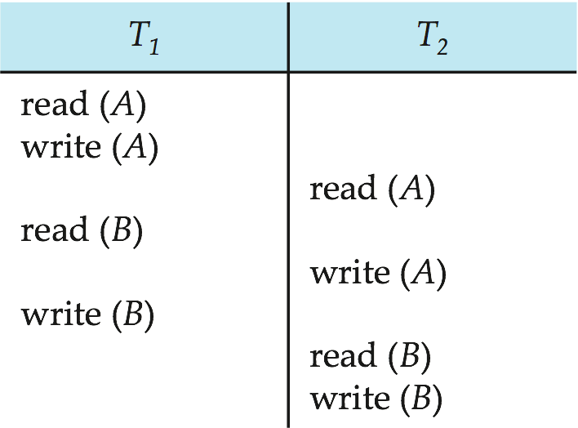
Figure 14.07

Slide 61
Figure 14.08

Slide 62
Figure 14.09

Slide 63
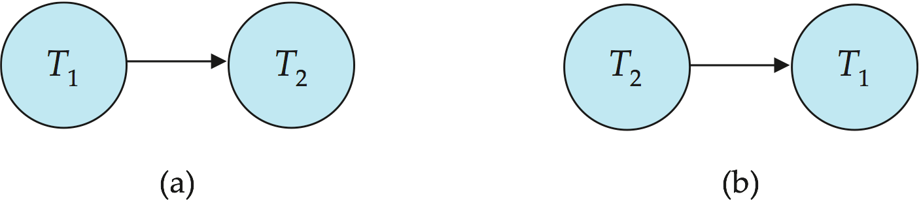
Figure 14.10

Slide 64
Figure 14.11

Slide 65
Figure 14.12

Slide 66
Figure 14.13

Slide 67
Figure 14.14

Slide 68
Figure 14.15

Slide 69
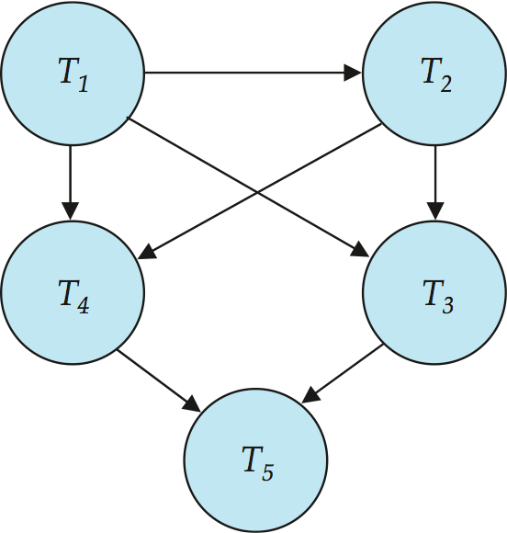
Figure 14.16

